Slide 1

Competitor Intelligence Dashboard

Slide 2





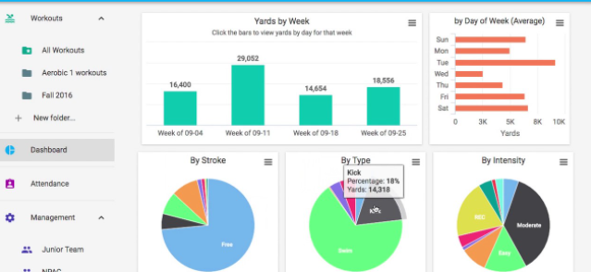









Technology combined with Pharma Knowledge : Competitor Intelligence Dashboard {Clinical Trials}
Deep functional knowledge
With no key changes
CT.Gov Trialtrove
Chinese
API
Periodic
calls
Defined
websites with
fields
Data scraping Engine
Local
System’s
Data Processing
ML Model
Req. Gathering & Data Understanding
With key Changes
User Interface and Alert Engine
Data Extraction
Data Processing
Data Ingestion
CI Tool

Slide 3
CI Dashboard – Solution
Solution :
Integrated CI Dashboard contains Clinical Trials data from various clinical trial registries such as Clinicaltrials.gov, Chinese Clinical Trial Registry, Trialtrove etc. Currently we cover Clinicaltrials.gov, we will include other clinical trial registries data in near future.
Intelligent data search functionality to the user to search the specific clinical trial in minimal time.
Alerts and notifications to the user in case any change in extracted information as compared to previous one is detected
Download of complete clinical trial data in user designed fashion and use it for their regular purpose, which they are doing it manually.
Download log of history of changes detected in the clinical trials, which helps user to do quick analysis on trial progress and competitive tracking which saves analyst time.
User can have access most recent updated news from all the competitors in a single provided with advanced keyword search functionality.
Developed Advanced Analytics with insightful graphical representations with advanced search functionalities, which allows users to drill down their search and extract all possible insights happening in competitor space.

Slide 4
CI Dashboard – Benefits and Clients
Client follows most labour Intensive approach in :
Manual data collation on key indications or competitors.
Manual tracking of clinical trials from clinical trial registry websites for data collation
Manual tracking of news from competitor segments for data collation
Manual update of master data tables
High demand on analyst time
Types of Clients:
Pharma Companies
Biomedical Research Institutes
Pharma Investors

Slide 5
CI Dashboard – Additional Modules Planned for Next Releases
Application of advanced Machine Learning Algorithms that helps the user for enhanced analysis of competitor space
Entity Recognition Engine
Sentiment Analysis on the clinical trial updates happening across the world
Build Predictive Analytics on clinical trials and enhance Outcome Predictions
Patient enrolment analytics and related stats

Slide 6
Thank You

